Slide 1
Welcome to Markit
An easy way to attendance.
Mark, Check, Scan or Simply search anything you want.

Slide 2
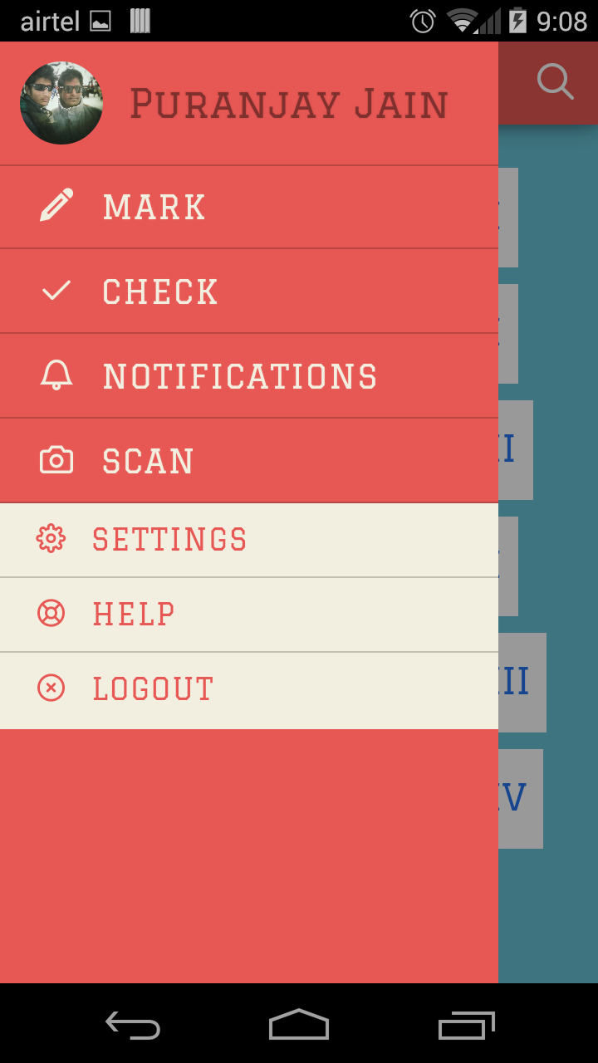
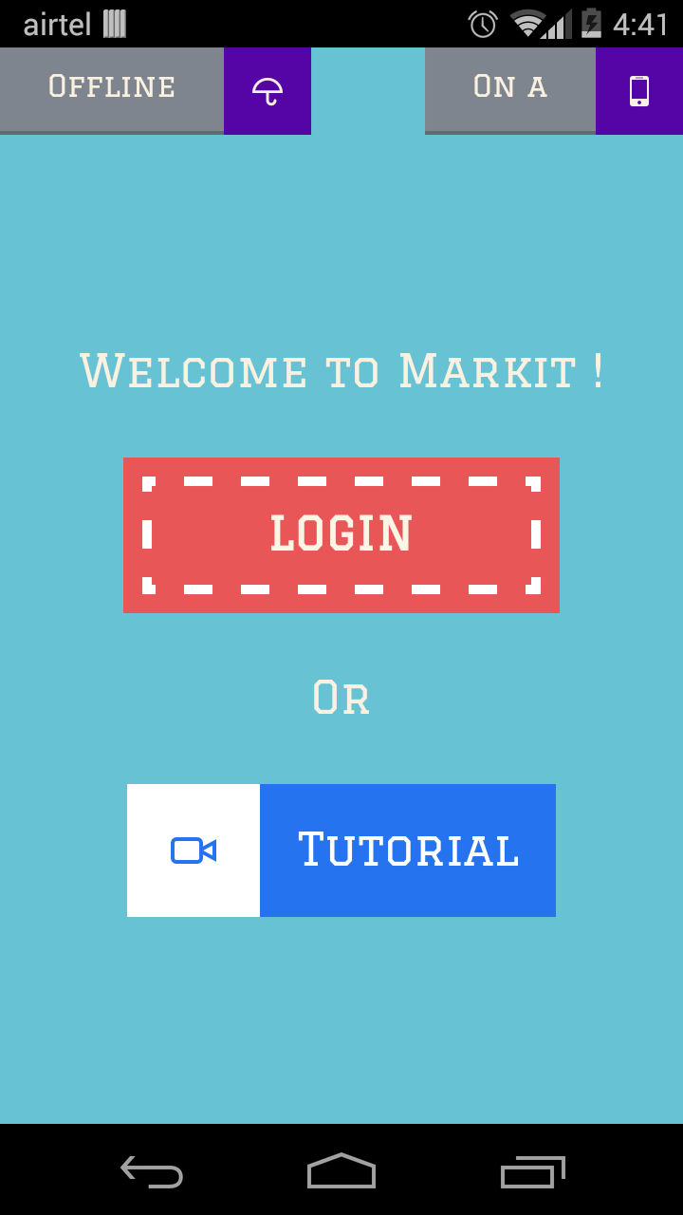
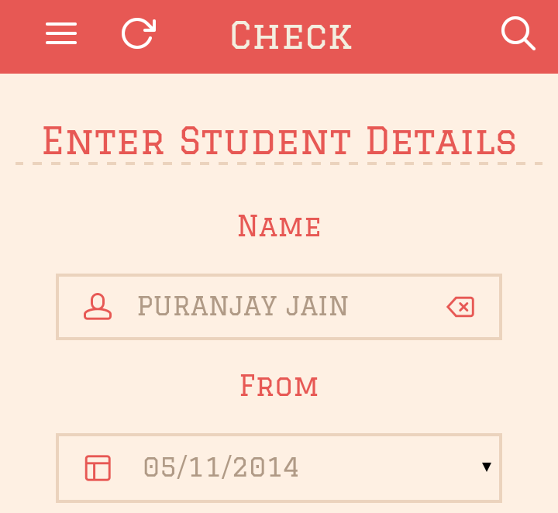
Design
Right from the start, you’ll have access to beautiful, color and text that will seamlessly transform into a theme that has layouts and transitions to match our college’s style. It just draws from the very essence of our college and the colors from the previous E.R.P module but drastically improvising it.
New features like Swipe and Tap Menu or the Universal Search bar make your work simpler than ever before.
The Application also draws elements from the material design by google for the latest version android available for older android™ phones !

Slide 3
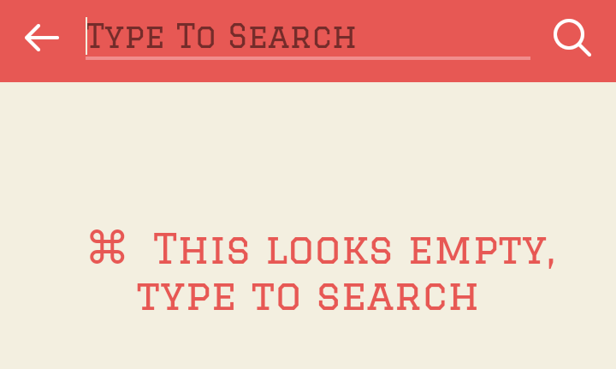
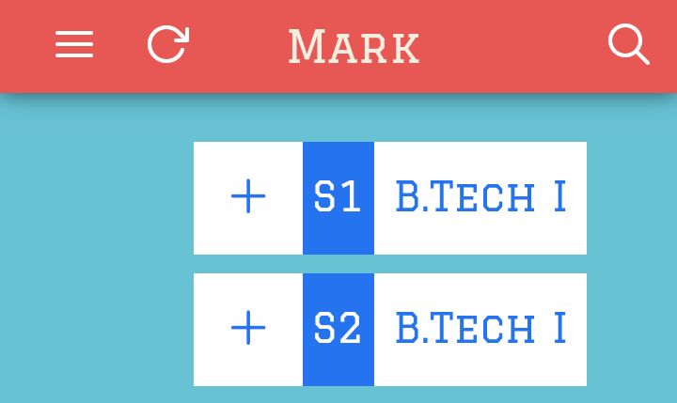
Interactions
Interact with the application with natural flow of fingers like tap or swipe. The familiar iconography makes it easier to recognize, if not help is always provided to those who need it.
Universal Search – Just tap to search . Search anything ranging from a fellow faculty or a student, settings or even help topics making work child’s play
Sleek Menu – Swipe right or just tap the icon for the menu. Familiar android icons with page descriptions or the circular photo with your name which links to your profile. Navigation is just a piece of cake

Slide 4






What’s in it for the Teachers
For teachers it is a great and easy way to mark the attendance
Integrated Offline Support
Suggestions based on the daily schedule
Notifications for All
Set Parameters like minimum attendance criteria for exam
Set your custom debar list
Interact directly with the students - no middle men

Slide 5






What’s in it for the Students
For students it is an accessible and a powerful tool
Keep track of schedule
Get alerted for low attendance beforehand
Get flexible periodic reports
Request attendance review – happy student
Your Profile, your style
Compare your standing in your class or the entire batch

Slide 6
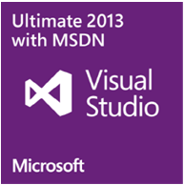





So how was it made possible ?

Slide 7
Coming up Next …

Slide 8


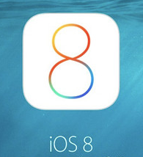

Support for more Platforms !

Slide 9
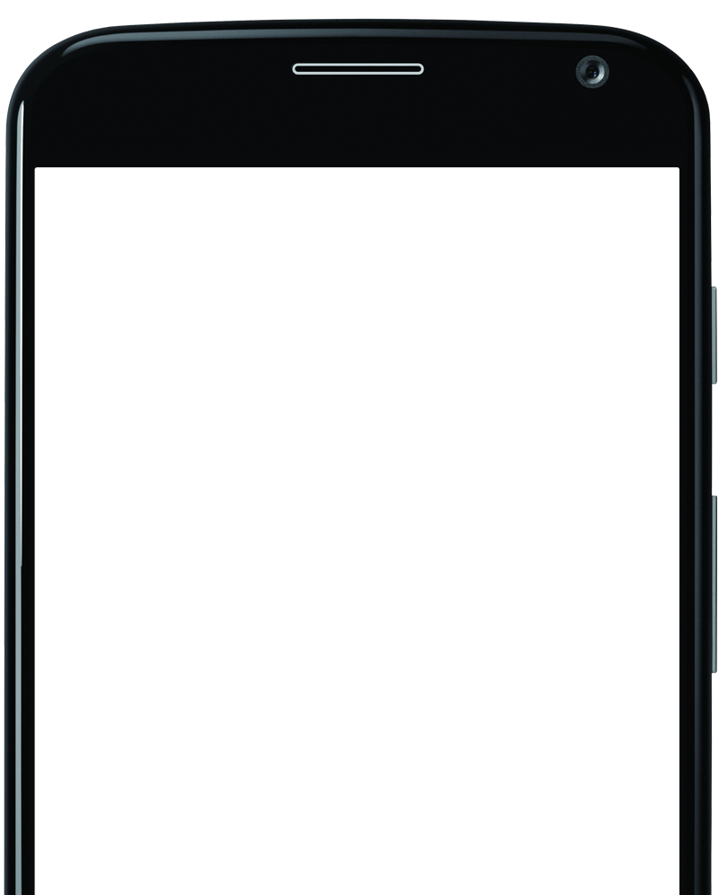
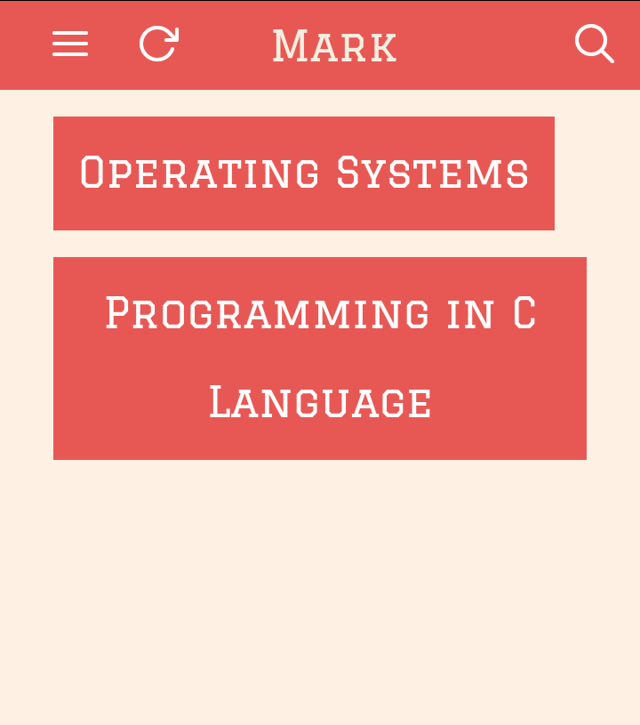
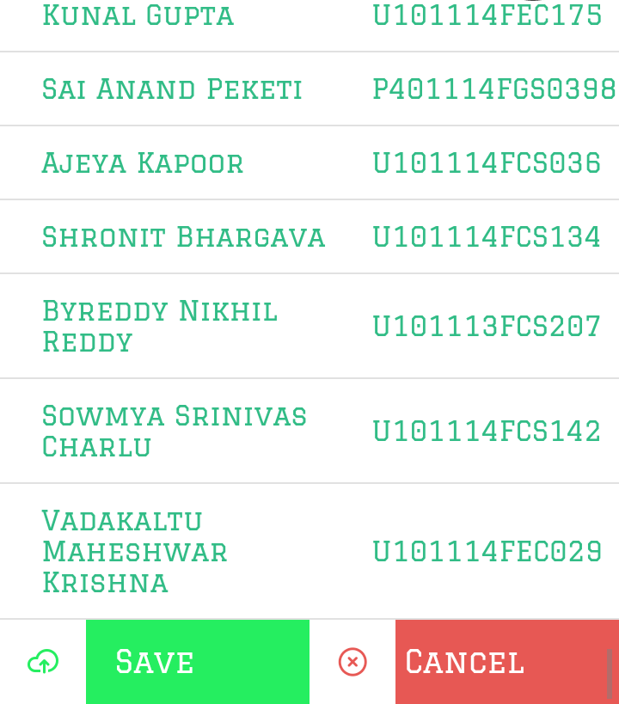
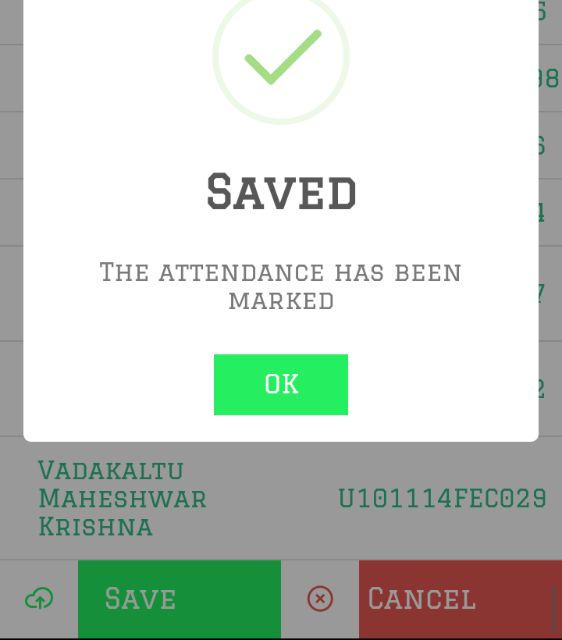
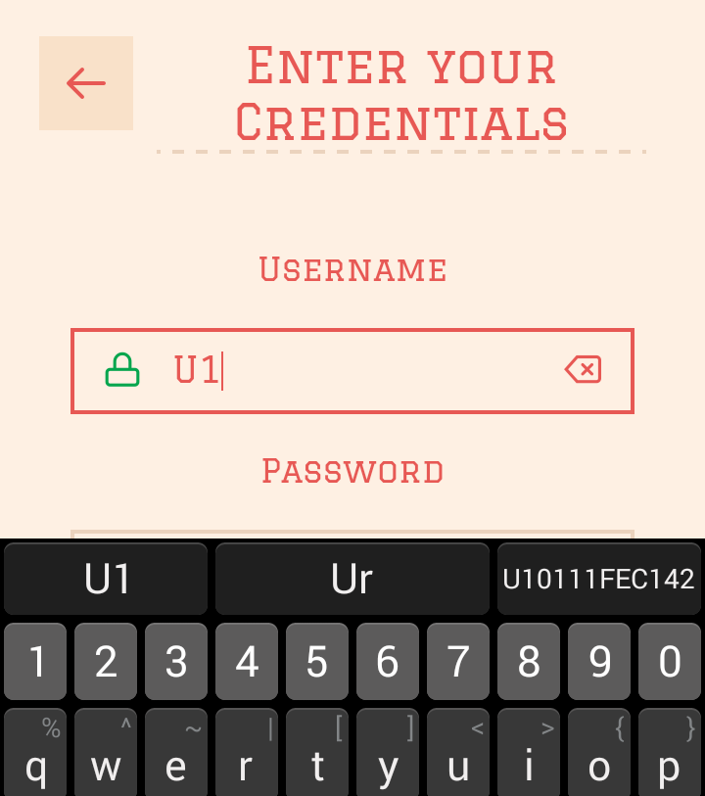
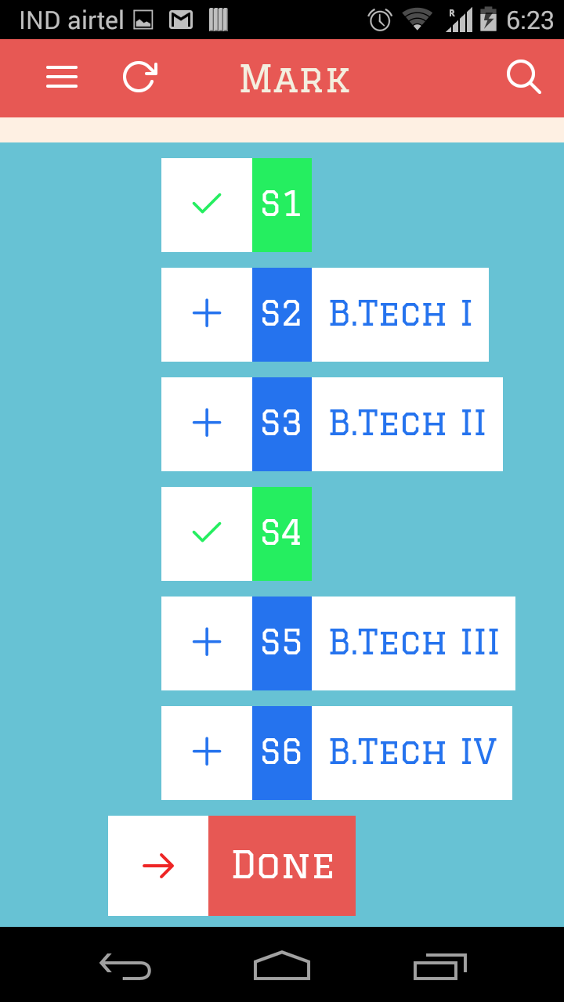
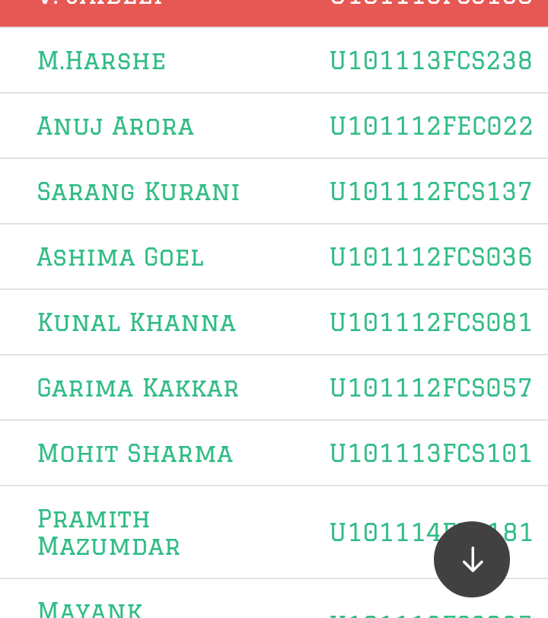
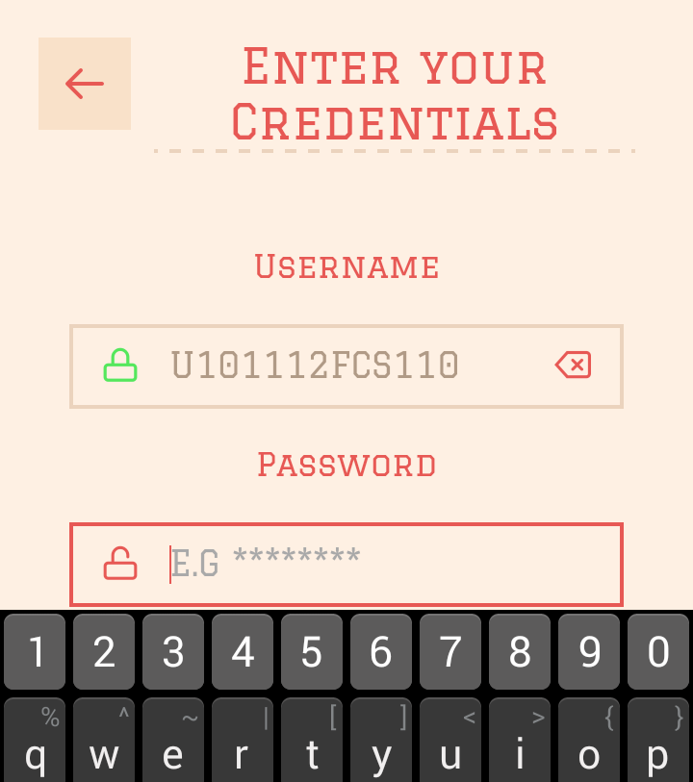
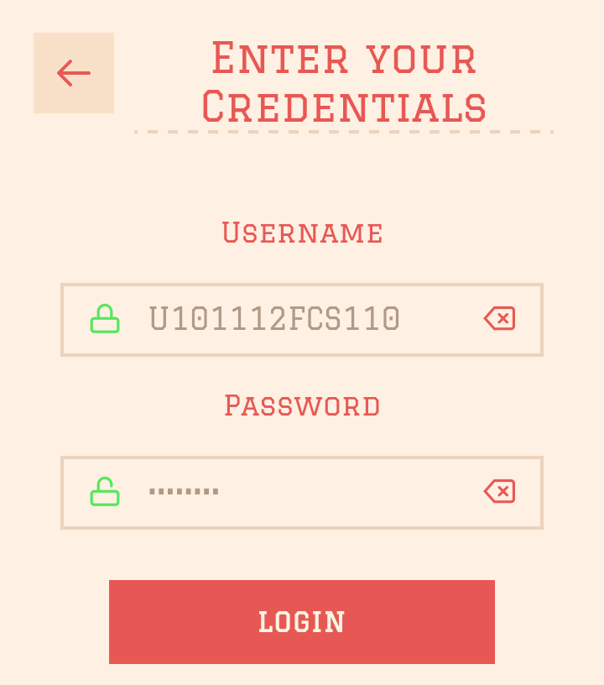
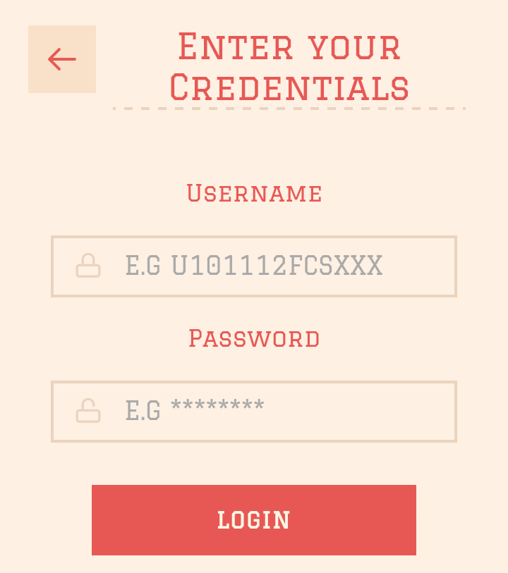

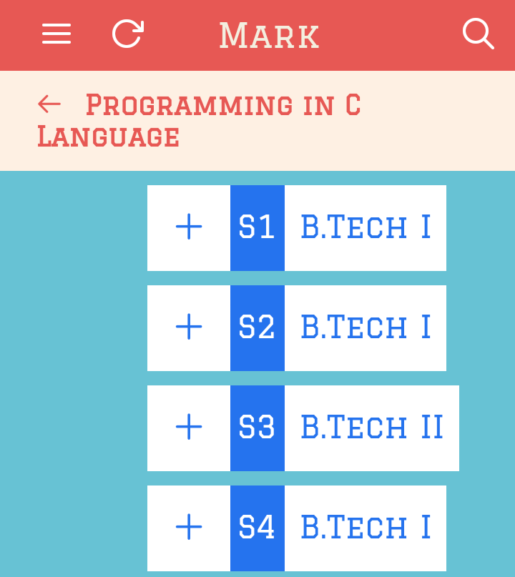
… And where can I get it
Google™ Play Store™

Slide 10
Markit by Puranjay Jain
Created for the Learning Technologies Project Course ( PBL ) under
Mr. Akhlesh Agarwal
with the guidance of Dr. Shradha Kanwar,
Mr. Ashoo Dubey and Mr. Vijay Mandke
Find out more on the ETIC Portal website
Notes:
In Slide Show mode, click the arrow to enter the PowerPoint Getting Started Center.

